Slide 1


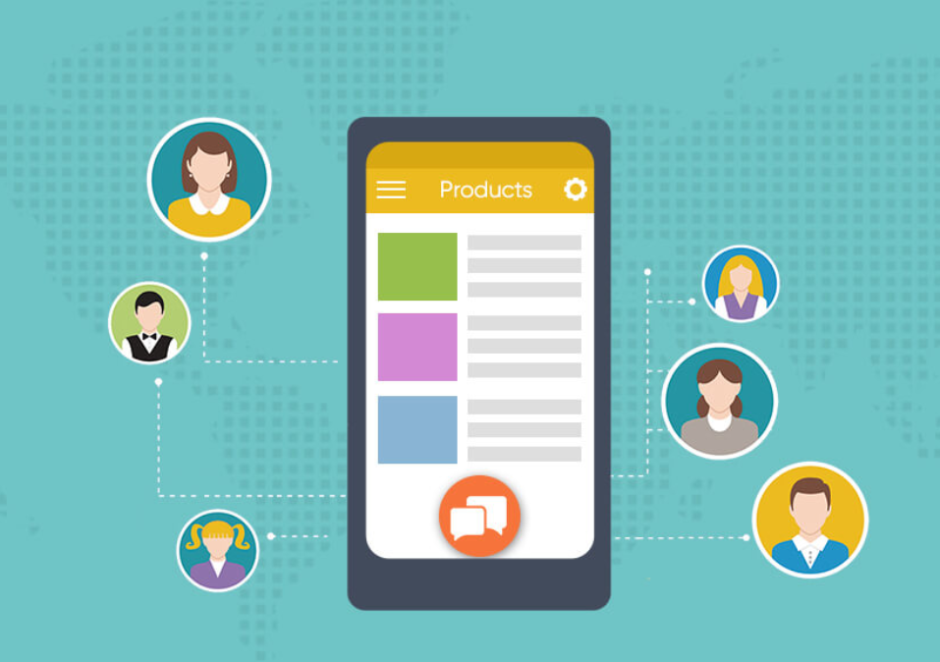
CHAT APPLICATION
Submitted by: Aishwarya Tembhurne
Submission type : Individual
Name: Aishwarya Tembhurne
Batch : Axis Bank Fintech Batch 12
LMS Id : aishwarya12
Program : Axis Bank Fintech Batch 12
Date: 31/05/2023
Git Link: https://github.com/aishwaryatembhurne/Chat-Application

Slide 2

Table of Contents
Introduction
Project Overview
Architecture Design
User Interface Design
Back-end Development
Front-end Development
Testing
Conclusion
Future Work
References

Slide 3
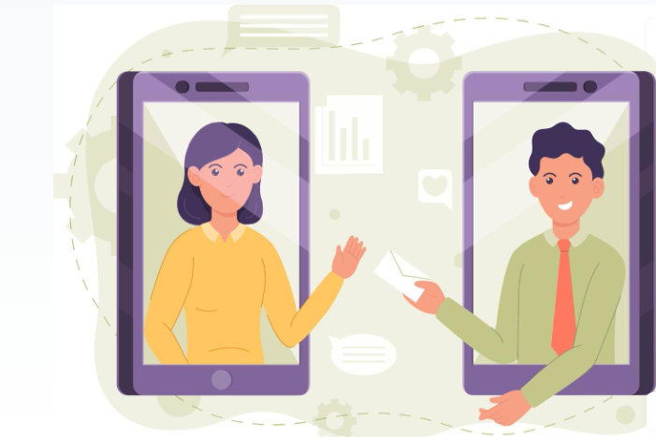
Introduction
This Chat Application is called Chat Me.
It is web-based chat application that allows users to send and receive message in real time. The primary purpose of the chat application is to provide a simple and effective way for users to communicate with each other.
In this application user can register himself, and chat with people individually or in groups with different users. Users can experience chats from anywhere.

Slide 4


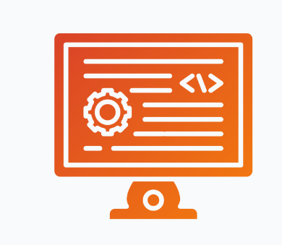
Project Overview
DATABASE
(SQL)
BACKEND
(SPRINGBOOT)
FRONTEND
(JAVASCRIPT,
CSS,
BOOTSTRAP)

Slide 5
Project Overview
FUNCTIONALITIES:
User Registration -- User can register in the application.
User login -- User can login after the registration is completed.
Validation -- User are validate through providing correct format of email and password should be more than 8 characters only, then only the user can register himself successfully.
Unique User -- User’s register themselves with the email id’s, that are unique . Same user cannot register himself with the same email id.
User Profile -- User can upload a photo in the profile, even if user don’t keep the profile photo the default photo is generated.
Group Chat -- User can create groups by adding different users, naming the group chat, removing user that existed in the group, and also can leave group.

Slide 6
Project Overview
FUNCTIONALITIES:
Search -- User can search the user that are present in the chat application and can message them privately, or and add in group.
Profile -- User can see the other user profile in the private chats. And he can view his profile in the chat page.
Chats -- User can send messages and also can receive messages from users.
Logout -- User can logout himself successfully after the chats.

Slide 7
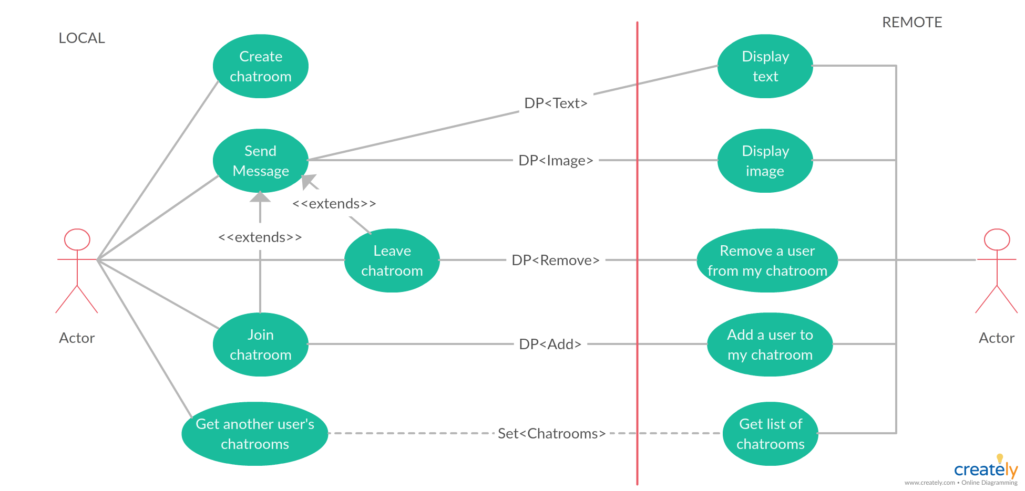
Architecture Design

Slide 8
Architecture Design
Front-end :
The application is designed to adapt seamlessly to different screen sizes and devices. UI components such as chat bubbles, message input forms, and contact lists are designed for optimal user interaction. Socket-io is used for real time chatting.
Back-end :
The back-end consists of servers that handle the logic, processing, and storage of data. RESTful APIs are designed to enable communication between the front-end and the back-end. The back-end handles user authentication, message routing, notifications, and other essential functionalities.
Database :
The application utilizes a database system to store user profiles, chat history, and other relevant data. The database is designed with appropriate tables, schemas, and relationships to ensure efficient data management.

Slide 9
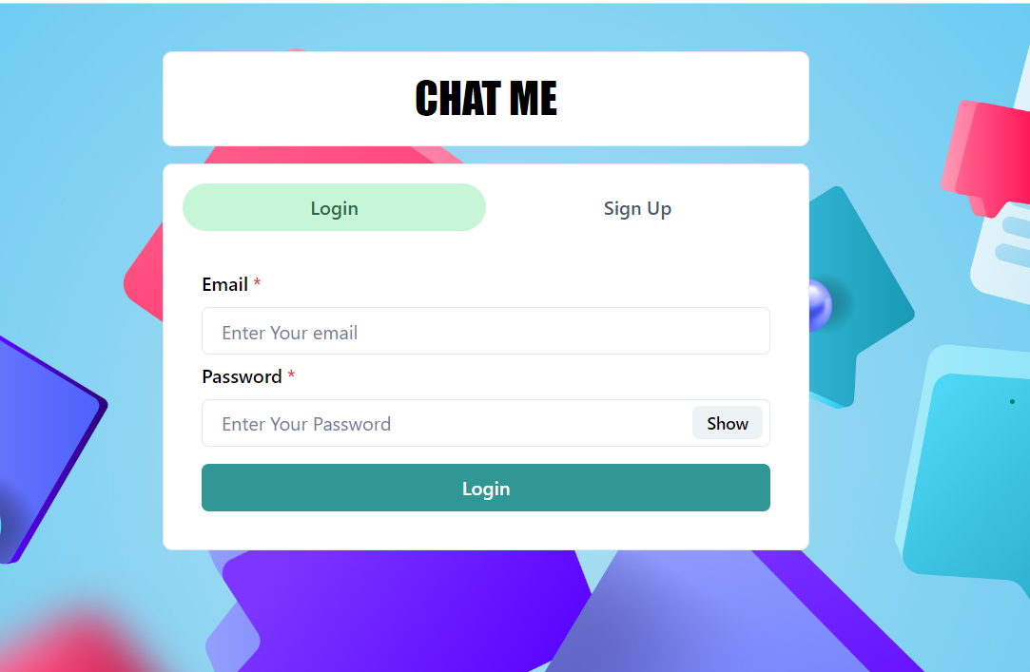
User Interface Design
Chat Login Page:

Slide 10
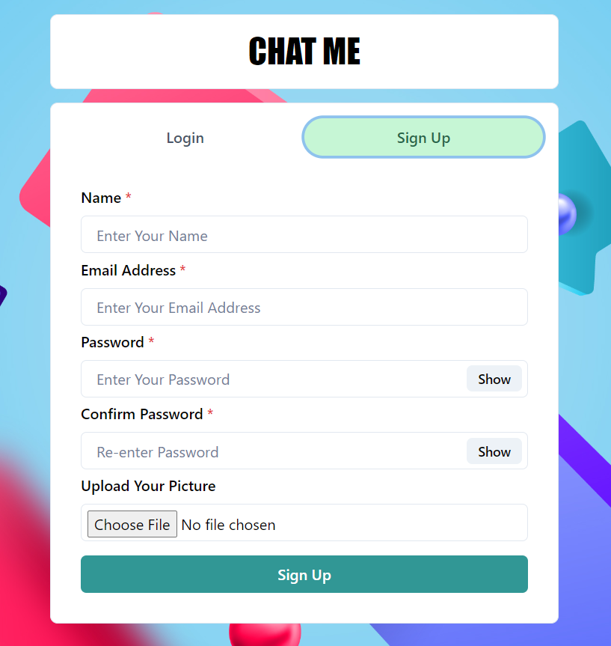
User Interface Design
Chat Signup Page:

Slide 11
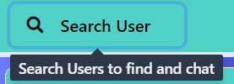
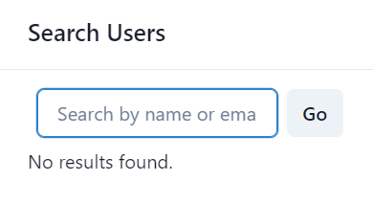
User Interface Design
Search:

Slide 12
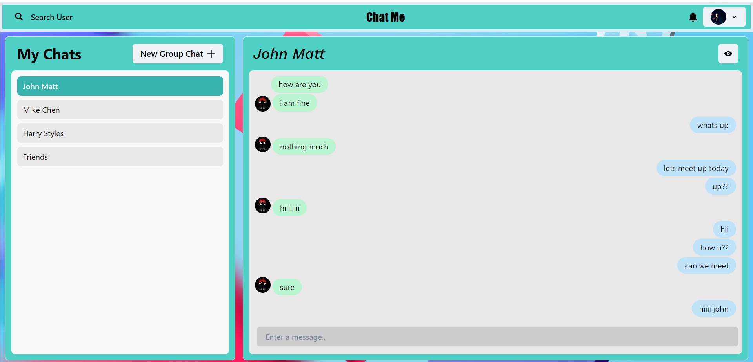
User Interface Design
Chat Page:

Slide 13
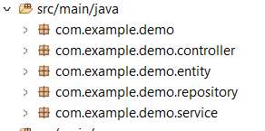
Back-end Development
Application is web based applications which is developed in
multi layer architecture.
In backend with the help Lombok we have reduce the boiler plate code in
the entities package.
Spring JPA is used along with hibernate for connection between the
database the backend server.
Dependencies like Spring web, Lombok, Dev tools, Spring JPA are used
in the backend.
Backend has different layers such as entity, repository, service, controller.

Slide 14
Front-end Development
React.js has been used in implementation of front-end.
Javascript, CSS, Bootstrap has been used for designing purpose.
Components like Login, Signup , Chat box for the project
have been implemented .
Axios is been used to connect backend with frontend.

Slide 15
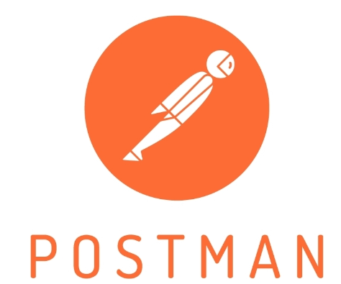
Integration and Testing
Postman :
A popular API testing tool, is utilized to validate the functionality of API
endpoints, such as sending and retrieving messages.
Postman allows sending various types of HTTP requests
(GET, POST, PUT, DELETE) to the API and analyzing the responses.

Slide 16
Conclusion
Chat Me application is user friendly chat application used for real time messaging purpose.
This application is developed with help of database, backend and frontend.
This application can create groups, chat privately, login with unique email ids, search users,
add delete users from group, view profile and logout.
Users Can chat from any where to other Users.

Slide 17
Future Work
Future scope for the application is :
1. Recieving real-time notification.
2. Sending images ,files, location, videos.
3. Blocking the user.
4. Reporting the user.

Slide 18
References
Java: Official Java Documentation (https://docs.oracle.com/javase/)
JavaScript: MDN Web Docs (https://developer.mozilla.org/en- US/docs/Web/JavaScript
React Documentation (https://reactjs.org/docs/)
Spring Boot Documentation (https://spring.io/projects/spring-boot)
Spring Framework: Spring Framework Documentation (https://spring.io/projects/spring-framework)

Slide 19

Conclusion

